Slide 1

Online Flipkart Shopping
Angular project
By Bhargav.M

Slide 2
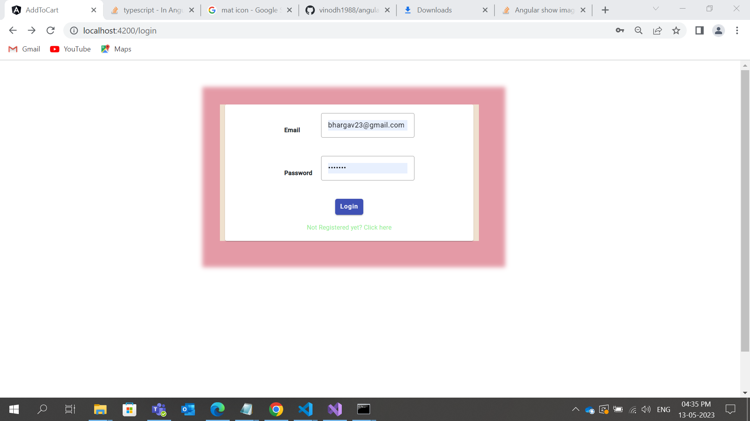
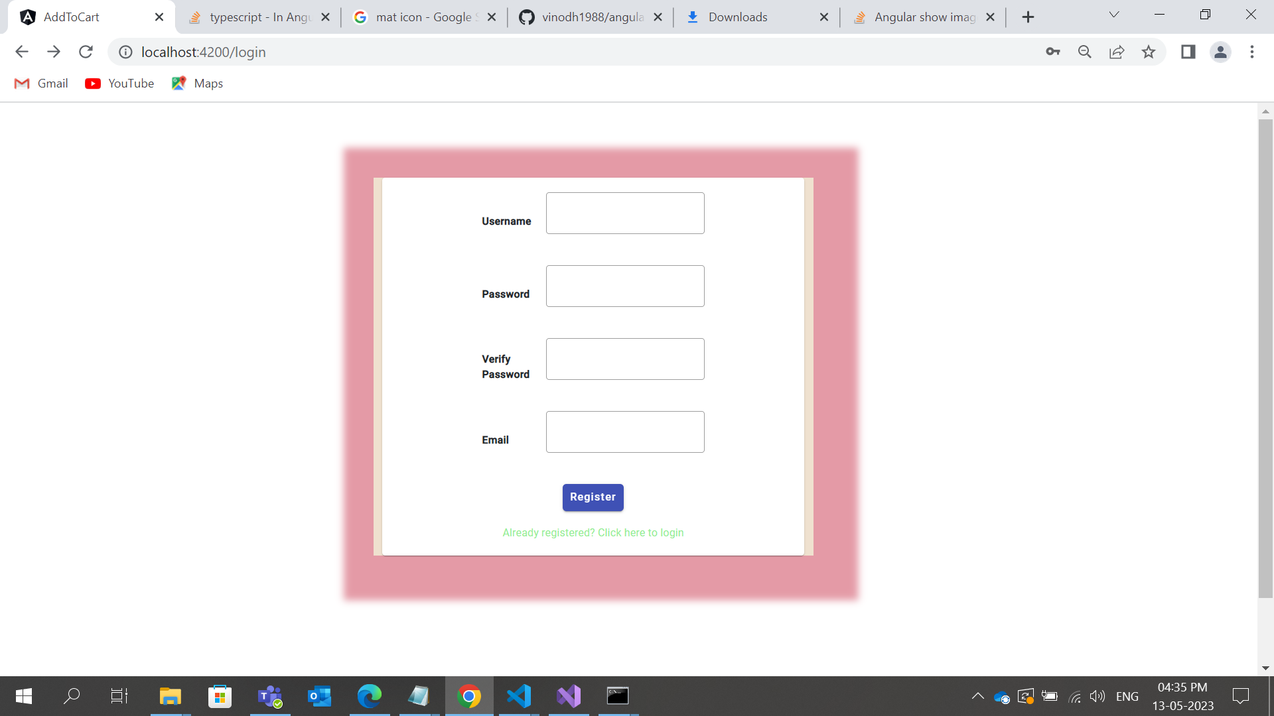
Login Component

Slide 3
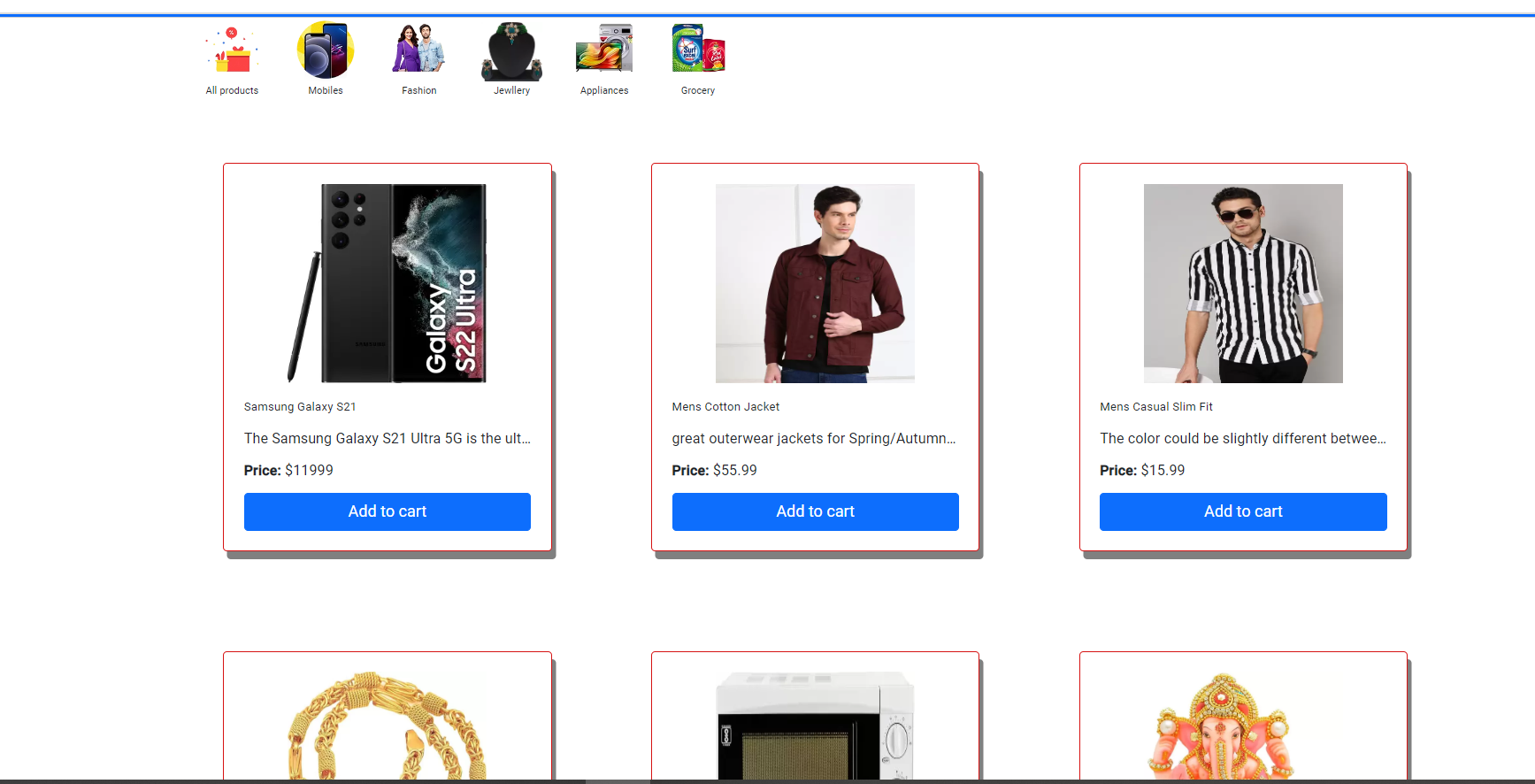
Login by user Home Component
It consist of all products
Like ……………………………………
Mobiles
Fashion
Jewelry
Appliances
Grocery’s

Slide 4
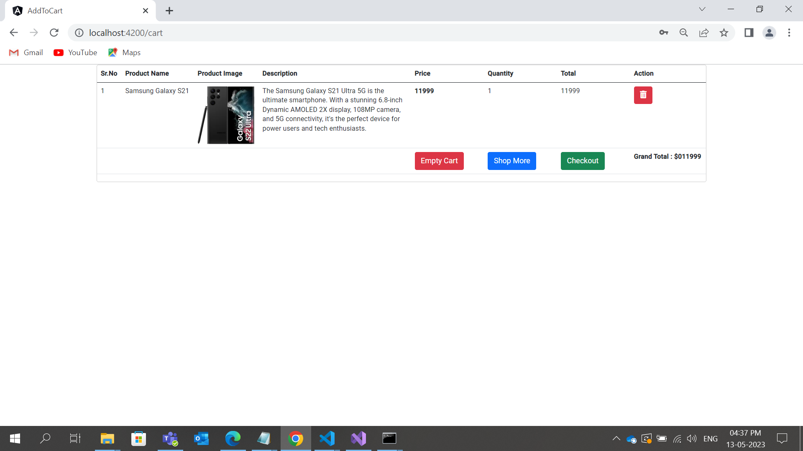
Add to cart
When product added to cart that product contains
1. S.no
2.product name
3.product image
4.description
5.price of product
6.quantity
7.total amount
8. if you want to shop more press shop more option it gets re direct to products page

Slide 5
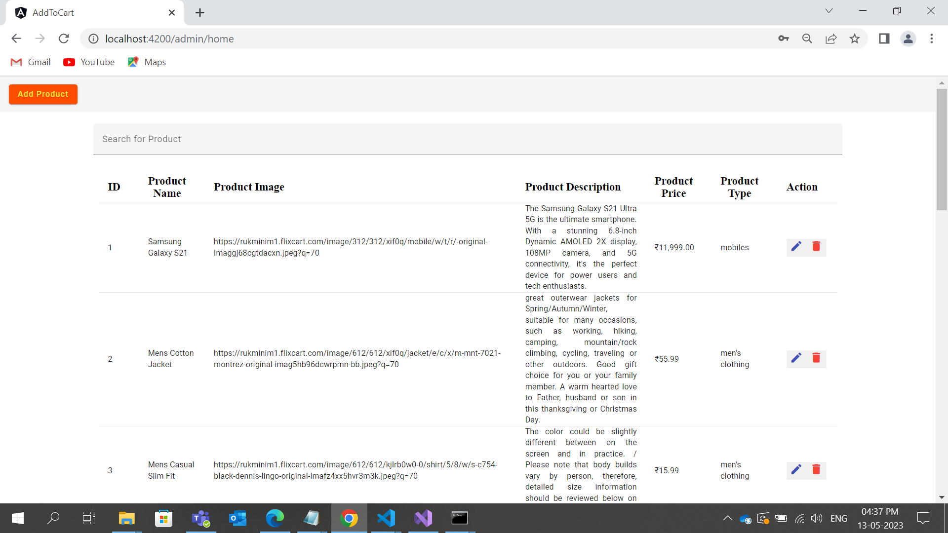
Login in Admin Component
Admin component contains functions like
1. Add products
2. search products
3. Actions like edit product & remove product
If we remove any product in admin, it gets removed in user also …

Slide 6

Thank you

